Slide 1
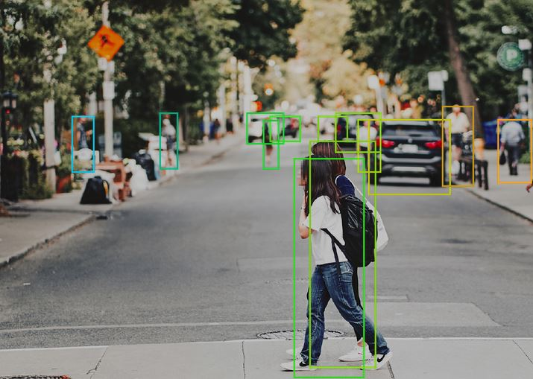
Final Presentation – Waymo’s Autonomous Driving Datasets – CNN Object Detection and Labeling
Ryan Patton

Slide 2
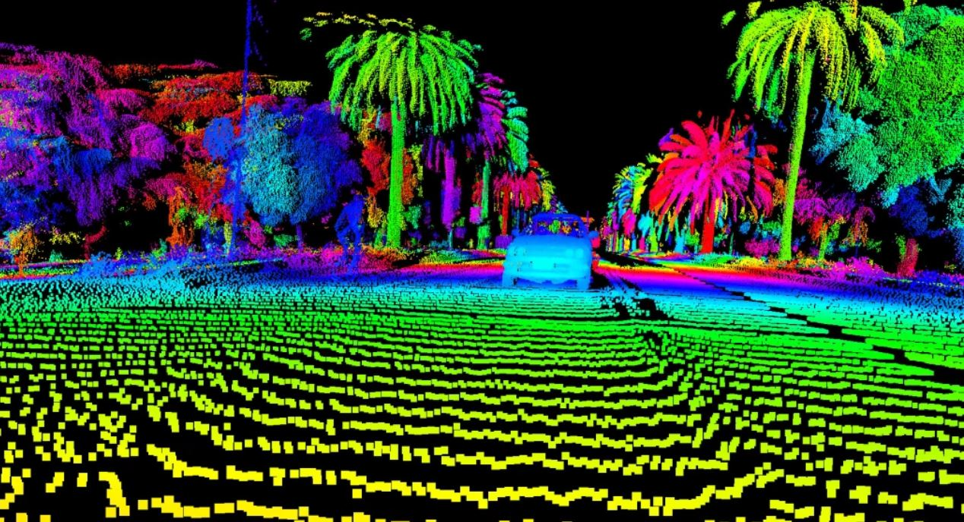

Slide 3
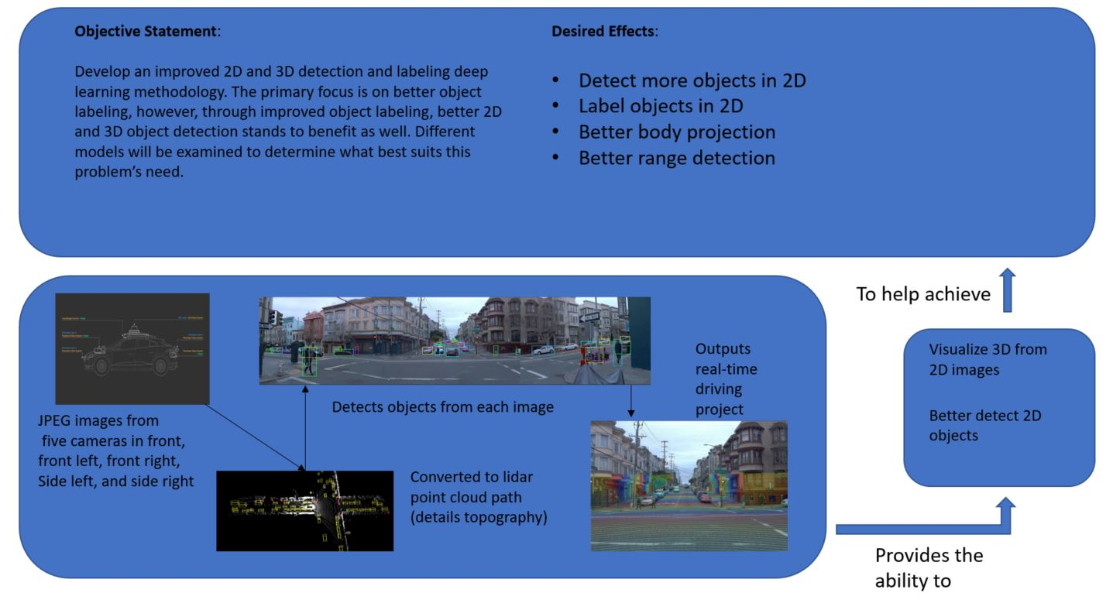

Slide 4
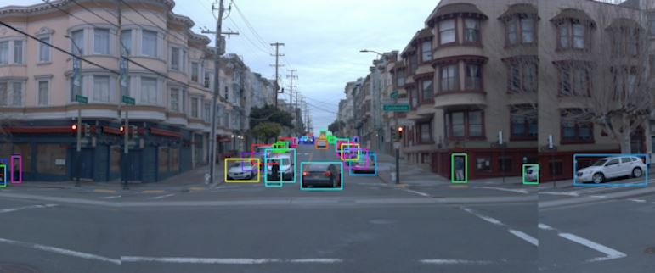
Object Detection

Slide 5
Datasets Introduction
Five Challenges:
3D Detection: given one or more lidar range images and the associated camera images, produce a set of 3D upright boxes for the objects in the scene.
2D Detection: given a set of camera images, produce a set of 2D boxes for the objects in the scene
3D Tracking: given a temporal sequence of lidar and camera data, produce a set of 3D upright boxes and the correspondence between boxes across frames
2D Tracking: given a temporal sequence of camera images, produce a set of 2D boxes and the correspondence boxes across frames
Domain Adaptation: similar to 3D Detection Challenge (1.), but additional segments are provided from a new location and only a subset have labels.
Waymo’s Open Datasets are comprised of high resolution sensor data collected by Waymo’s own self-driving cars in a wide variety of conditions and locations.
1950 segments of 20s each, collected at 10 Hz (200,000 frames). Largest and most diverse multimodal autonomous driving dataset to date.

Slide 6
Datasets Introduction Continued
Sensor Data
1 mid-range LiDAR
4 short-range LiDARs
5 cameras (front and sides)
Synchronized liDAR and camera data
LiDAR to camera projections
Sensor calibrations and vehicle poses
Labeled Data
Labels for 4 object classes – vehicles, pedestrians, cyclists, signs
High-quality labels for LiDAR data in 1,200 segments
12.6 3D bounding box labels with tracking IDs on LiDAR data
High-quality labels for camera data in 1,000 segments
11.8 2D bounding box labels with tracking IDs on camera data
Code
Open-source GitHub repositories are available
1,000 scenes for training and validation, 150 scenes for testing with each scene spanning 20 seconds.

Slide 7
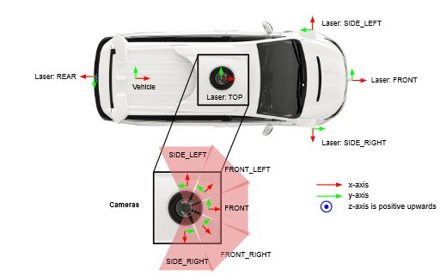
Collecting Data

Slide 8
Background Autonomous Driving Datasets
Most past AD systems fuse sensor readings from multiple sensors (cameras, LiDAR, radar, GPS, wheel odometry, and IMUs. Within the last decade, new datasets have been introduced that include:
Synchronized stereo camera, LiDAR sensor data in multiple sequences that enable 3D object detection and tracking, visual odometry, and scene flow estimation
Per-pixel semantic annotations and pose information with respect to static background point clouds
Group scenes recorded with thermal imaging cameras
3D LiDAR sensor readings in dense urban areas specifically
Environment map information
Geometric and semantic maps with ground height and vector representation of road lanes and their connectivity

Slide 9
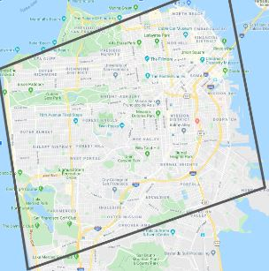
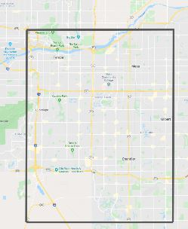
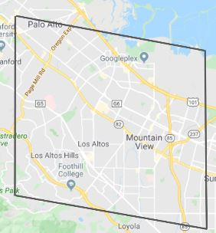
Ego Poses

Slide 10
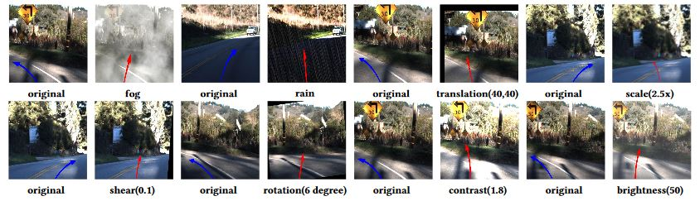
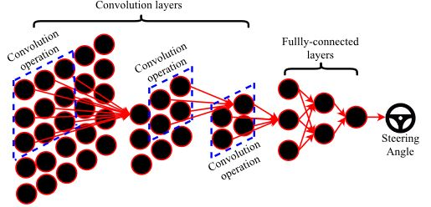
CNN and Vehicle Pose
Shows how different conditions are affecting the images and the pose of the vehicle, and how pose affects object detection in CNN

Slide 11
Paramaters
Convolutional 2D – R-CNN
Input: (66, 200, 3) – Lambda Layer
Cropped image size
Max pooling
Filters: 24, 36, 48, 64
Strides: (5,5), (3,3)
Loss: Mean Squared Error
Epochs: 8
Batch size = 20
Regularization: dropout
Activation Functions: ReLu
Loss Values: (Best was ~0.11 with Elu), Relu and Sigmoid between ~0.15, 0.20)
Optimizers: Adam
Data Augmentation used (avoids overfitting)

Slide 12
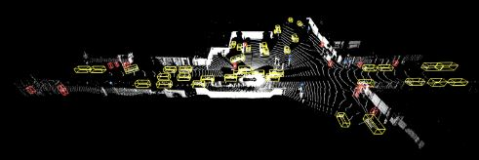
LiDAR Label Example
Key
Yellow = Vehicle
Red = Pedestrian
Blue = Sign
Pink = Cyclist

Slide 13
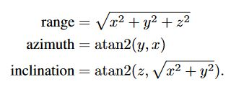
Coordinate System & Ground Truth Labels
Coordinate Systems
Global frame: set prior to vehicle motion, East-North-Up coordinate system – Up (z) for gravity, East (x) for latitude, and North (y) for north pole
Vehicle frame: moves with vehicle, x-axis is + forwards, y-axis is + left, z-axis is + upwards. Pose is 4x4 transform matrix from vehicle to global frame
Sensor frame: defined for each sensor, a 4x4 transformation matrix that maps data from sensor to vehicle frame
Image frame: 2D coordinate system defined for each camera images, +x is along image width and +y is along image height, origin is top left corner
LiDAR spherical coordinate system: Cartesian coordinate system →
Ground Truth Labels
Vehicles, pedestrians, cyclists are annotated in all camera images with a 4-DOF image axis-aligned 2D bounding box complementary to the 3D boxes and 2D projections (c_x, c_y, l, w)
Image labeling has been verified through repeated previous testing

Slide 14
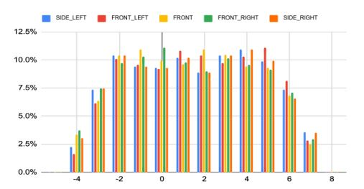
Sensor Data – Camera LiDAR Synchronization Accuracy
Synchronization accuracy:
cameracentertime − framestarttime − cameracenteroffset/360◦∗0.1s

Slide 15
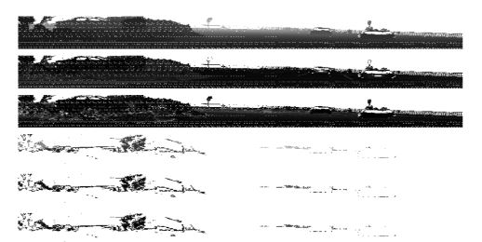
Sensor Data – Range Input
Range: distance between LiDAR point and the origin LiDAR sensor frame
Intensity: measurement indicating the return strength of the laser pulse that generated the LiDAR point, based on reflectivity of the object struck by the laser pulse
No label zone: field indicates where LiDAR point falls into a no-label zone (ignored for labeling)
Vehicle pose: pose at the time LiDAR point is captured
Camera projection: LiDAR point to camera image projections with rolling shutter effect compensated for

Slide 16
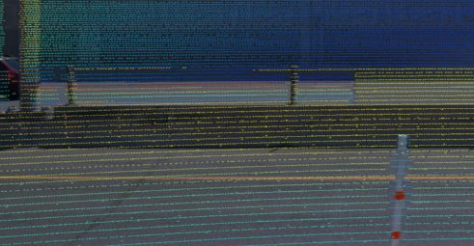
Sensor Data – LiDAR Point Projections
Example: projection algorithm output

Slide 17
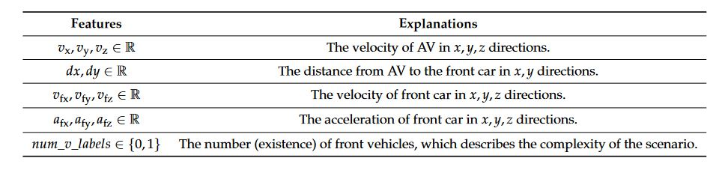
Sensor Data – LiDAR Point Projections

Slide 18
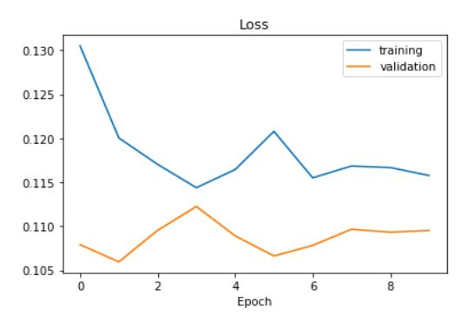
Results
R-CNN Params
Velocities in x,y,z directions
Distance to front of car
Velocity of front car
Acceleration
Number of front vehicles (complexity)
Shown above is training vs. validation for R-CNN (distance)

Slide 19
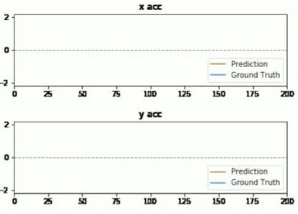
Results
Scenario: following a car from behind

Slide 20
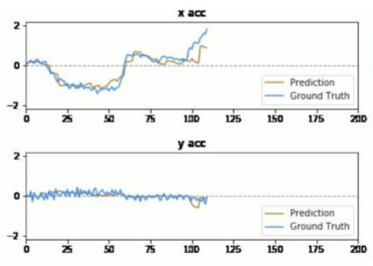
Results
Scenario: car in front of you is turning

Slide 21
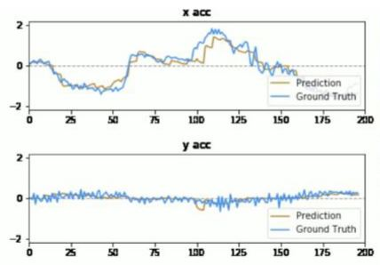
Results
Scenario: applying brakes at a stop light

Slide 22
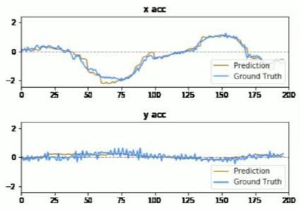
Results
Synchronized frames between camera angles

Slide 23
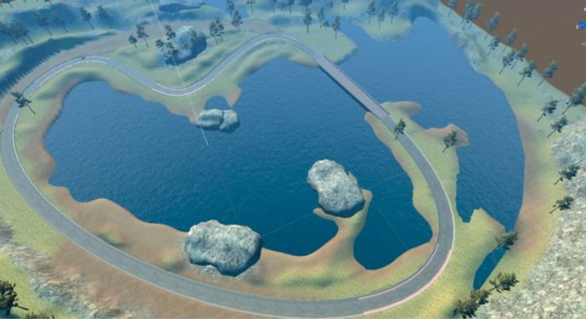
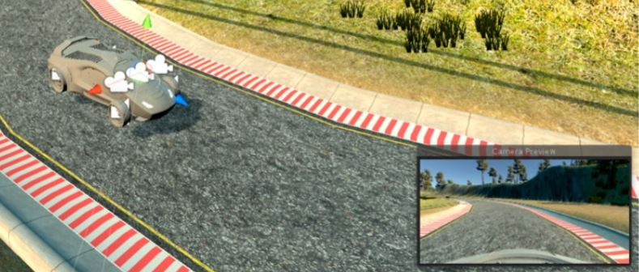
Future Work
Exploring more data with simulations

Slide 24
References
[1] Yukyung Choi, Namil Kim, Soonmin Hwang, Kibaek Park,Jae Shin Yoon, Kyounghwan An, and In So Kweon. Kaistmulti-spectral day/night data set for autonomous and assisteddriving.IEEE Transactions on Intelligent TransportationSystems, 19(3).
[2] Ming-Fang Chang, John Lambert, Patsorn Sangkloy, JagjeetSingh, Slawomir Bak, Andrew Hartnett, De Wang, Peter Carr,Simon Lucey, Deva Ramanan, and James Hays. Argoverse:3d tracking and forecasting with rich maps. InThe IEEE Con-ference on Computer Vision and Pattern Recognition (CVPR),June 2019.
[3] Abhishek Patil, Srikanth Malla, Haiming Gang, and Yi-TingChen. The h3d dataset for full-surround 3d multi-object de-tection and tracking in crowded urban scenes. InProceedingsof IEEE Conference on Robotics and Automation (ICRA).
[4] Charles Ruizhongtai Qi, Hao Su, Kaichun Mo, and Leonidas J.Guibas. Pointnet: Deep learning on point sets for 3d classifica-tion and segmentation.2017 IEEE Conference on ComputerVision and Pattern Recognition (CVPR), 2017.
[5] Shaoqing Ren, Kaiming He, Ross Girshick, and Jian Sun.Faster r-cnn: Towards real-time object detection with regionproposal networks. InAdvances in neural information pro-cessing systems.
[6] Andreas Geiger, Philip Lenz, Christoph Stiller, and RaquelUrtasun. Vision meets robotics: The kitti dataset.Interna-tional Journal of Robotics Research (IJRR), 2013.
[7] Xinyu Huang, Xinjing Cheng, Qichuan Geng, Binbin Cao,Dingfu Zhou, Peng Wang, Yuanqing Lin, and Ruigang Yang.The apolloscape dataset for autonomous driving. InProceed-ings of the IEEE Conference on Computer Vision and PatternRecognition Workshops.

Slide 25
Questions?

